Slide 1
Import XML
Import XML

Slide 2
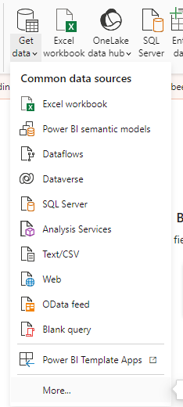
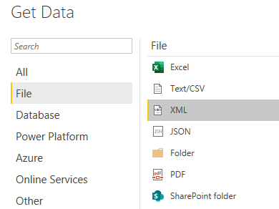
Import XML
Note: This lab uses the CustomerOrder.xml file located in the resources/XmlSources folder .
Select XML as the data source.
2
1

Slide 3
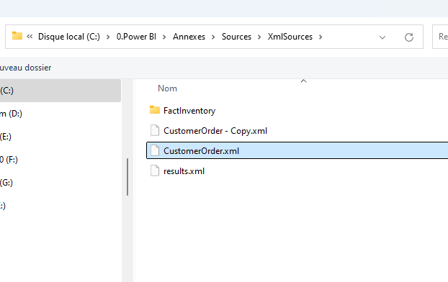
Import XML
The CustomerOrder.xml file of XML Sources

Slide 4
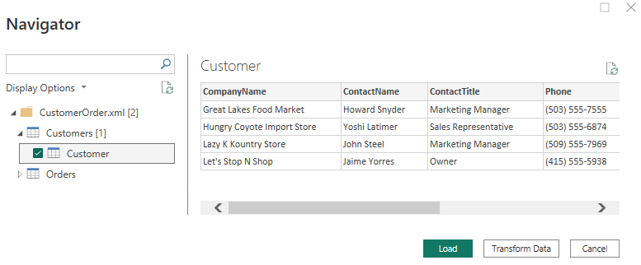
Import XML
Try selecting Customer only, then Order only, then both at the same time.

Slide 5
Thank you
Thank you

